Slide 1
Heavy metal and violence

Slide 2
Structure of the presentation:
Introduction
Observation and data analysis
Neurophysiology
Psychology
Conclusion

Slide 3
1. Introduction

Slide 4
Stereotypes
Extreme music is for extreme people
“We've never given in to the ways of the world… Yet it is the tenacity that encourages people to find their own ways to step up and deal with whatever issues they may have. There is that type of connection.” --- David Vincent (Morbid Angel)
Nerds/introverts/socially awkward prefer metal

Slide 5


Stereotypes cont.
Violence are highly related with and inspired by the music
“Music at loud volumes goes into your bones and violates a prisoner’s inner being as well as their external environment.” --- the Guardian
Music is sometimes weaponized.

Slide 6
Phenomena – THERE ARE MUCH VIOLENCE HAPPENING WITHIN HEAVY METAL…
Types of violence - physical/actions
Mosh pit
Circle pit
Wall of death
Diving/crowd surfing
Arson (black metal)
Accidents and riots (0:32-1:55)
…

Slide 7
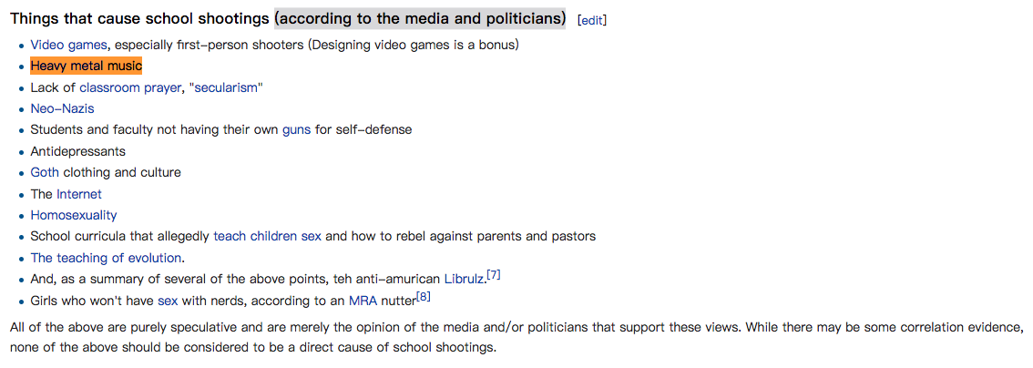

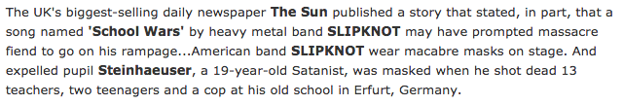
Types of violence – suicide/murder
Some notorious cases…
Suicide:
Judas Priest's "Better by You, Better Than Me”
Ozzy Osbourne's "Suicide Solution”
School shooting:
Erfurt school massacre & Slipknot’s “School War”
Columbine High School massacre & Marilyn Manson
Red Lake shooting
Alexis de Tocqueville school shooting
Serial killing:
AC/DC’s "Night Prowler" & Serial Killer Richard Ramirez

Slide 8
2. Observation and data analysis

Slide 9
More general correlation?
Heavy metal popularity and crime index geographically
# of bands per capita
% of active bands
not really correlation
Sales and charts
# of listeners per capita
Quality

Slide 10
Why stereotype? Reasons…
Heavy metal
Musical/extra-musical elements
Elements have impact on cerebral/emotional activity
→ Activities lead to violence

Slide 11
The sound/music itself
Loudness (amplification)
Loudness map by genre
Noisiness (distortion)
Where does noise come from?
Amplification (raise of voltage) —> distortion (waveform tends to be “continuous”) —> “noisy”
Heavy metal is perceivably LOUDER and NOISIER than other genres
?..

Slide 12
Lyrics
Revisit: the triggering songs
(Demo) Example: Ozzy Osbourne's "Suicide Solution”
How? Can we trust the machine? Related: Spotify web API: get audio features of a track
(For geeks: Algorithm used is called Truffle Pig)

Slide 13
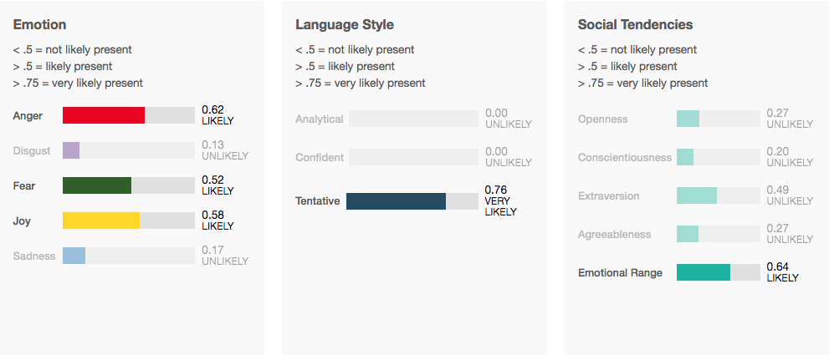
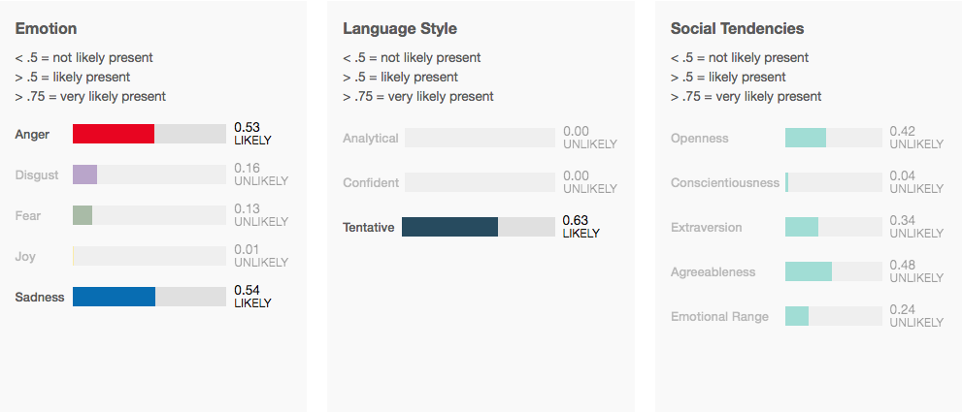
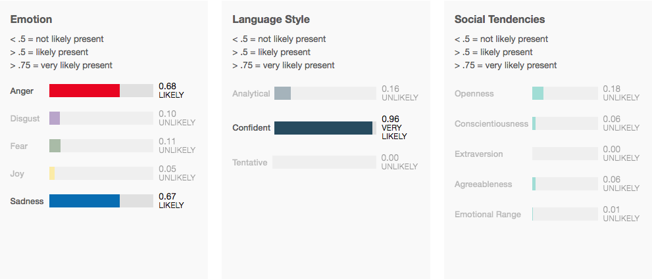
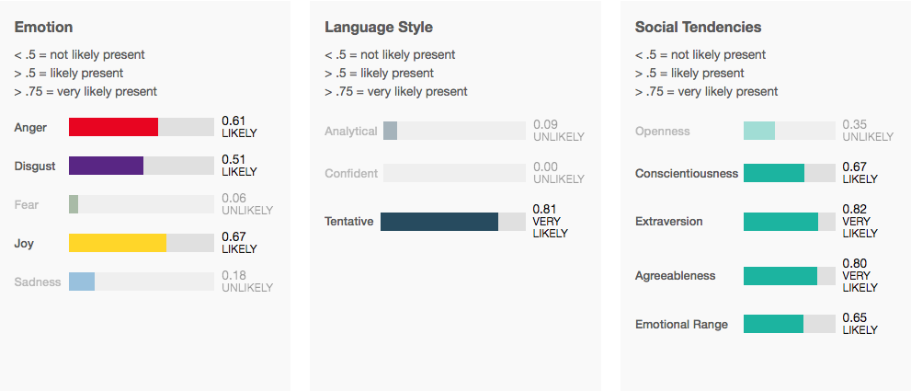
AC/DC’s “Night Prowler”
Ozzy Osbourne's "Suicide Solution”
Slipknot’s “Duality”
Marilyn Manson’s “The Beautiful People”

Slide 14
Mastodon’s “Oblivion”: sadness
Gojira’s “The Heaviest Matter of the Universe”: fear
Opeth’s “Forest of October”: sadness
Baroness’s “Take My Bones Away”: sadness
Heavy metal song lyrics express sadness and anger, tentative, but differ from sub genres
A venting-out?...

Slide 15
Music and lyrics combined
(Demo) KLANGSPEKTRUM
→ Heavy metal music is highly energetic
→ A venting-out?...

Slide 16
Emotions
“There were some songs born with a riot.” --- Motoji Matsuda (an anthologist at Kyoto University)
When a riot happened in Nairobi, a protest song was sung by a large crowd.
A bunch of songs were born with wars
After the thirty years war, march of the Finnish cavalry was made in Finland.
“The army goes rolling along” official song of the United States Army.

Slide 17
Heavy metal popularity and crime index geographically not really correlation
Heavy metal is LOUD
Heavy metal is perceivably NOISIER than other genres
Heavy metal music is highly energetic
→ A venting-out?...
→ 7/7 cases related to heavy metal show correlation with personal and familial reasons, coincide with heavy metal, music is not to blame
Question still remains…

Slide 18
3. Neurophysiological point of view

Slide 19




Generally about human behavior
EMPATHY
Be able to feel emotions of each other
or in the case of the music understand the composer’s intention
Notes:
And why the interaction between humans are strongers , because each of us is able of empathy

Slide 20
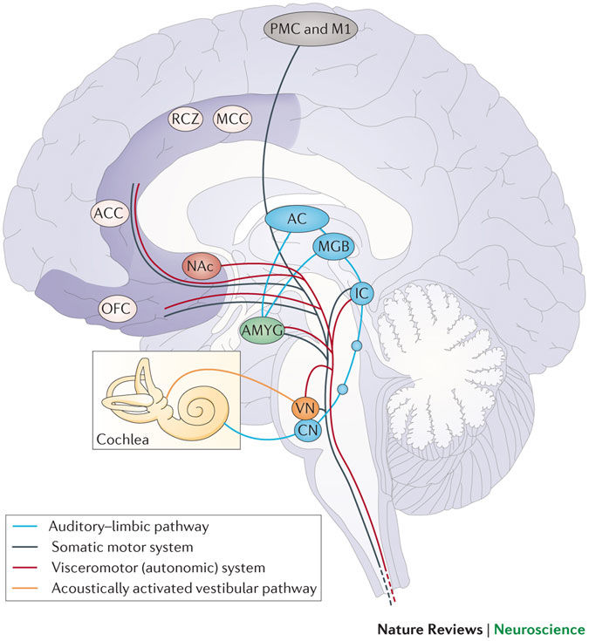
How is Music perceived?
STIMULI
BRAIN ACTIVATION
feedback to equilibria
PHYSIOLOGICAL CONSEQUENCES
or motor reaction
EMOTION

Slide 21
Can we establish a link between angriness and the music like heavy metal ?
Extreme metal music and anger processing, published in 2015, in Frontiers in human neuroscience Leah SHARMAN & co
extreme music causes anger
extreme music matches and helps to process anger

Slide 22
Extrem metal music and anger processing, published in 2015, in Frontiers in human neuroscience Leah SHARMAN & co
protocol :
Among a population of heavy metal listeners
3 conditions ( adding to the baseline) :
-> Angry interview = stress condition
-> Music
-> Silence
The scientists picked up the heart rate and presented a PANAS to the sujet

Slide 23
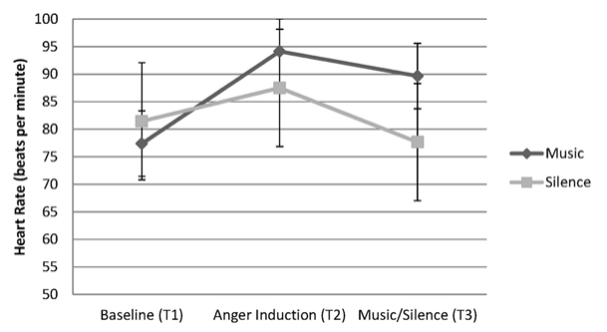
Heart rate increases for angry condition and stays high with the heavy metal listening whereas decreases dramatically in the silent condition.

Slide 24
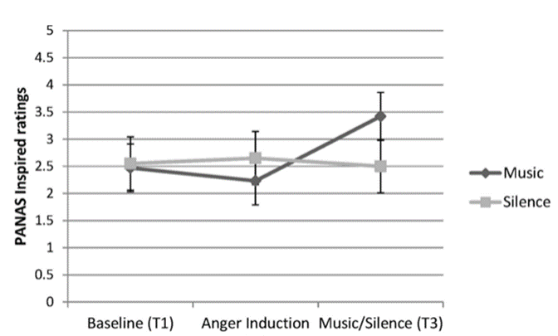
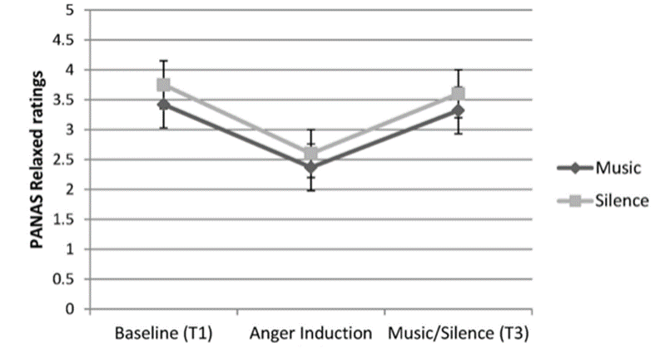
Heavy metal listeners feel as relaxed listening Heavy Metal as in the silent condition.
Heavy metal listeners feel more inspired listening Heavy Metal than in the silence condition and the stress condition

Slide 25
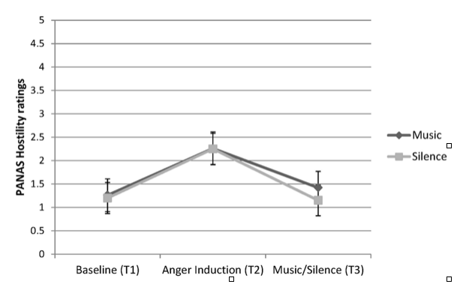
The hostility decreases in listening heavy metal as the silent to compare with the stress condition.

Slide 26
Can we establish a link between angriness and the music like heavy metal ?
Heavy metal brings positive emotion to Heavy metal listeners.
The study doesn’t demonstrate a correlation between angriness and heavy metal
The hypotheses to explain the high heart rate is that Heavy increase a motivational behavior of metal listeners.

Slide 27
Psychological point of view

Slide 28
Psychological perspective on aggression
Based on a study article: Resting arousal, sensation seeking, and music preference (McNamara & Ballard 1999)
Key terms:
Resting arousal: the level of activity in various bodily organs during inaction
Sensation seeking: need for varied, novel and complex experiences, and willingness to take physical and social risks to get them
Both of these are highly affected by innate physiological characteristics
→ study: is there a relation between these two and music taste?

Slide 29
Concerns about rock music and behavior
(In this study rock music includes heavy metal)
Concern about aggressive behavior
Concern about antisocial behavior

Slide 30
1) Aggressive behavior
Some studies show that violence in lyrics doesn’t affect people’s anger and hostility
Connection between anger and rock music has not been found in studies
On the contrary: one study found that listening to heavy metal music while angry, people relaxed and felt more in control of their feelings
It has been suggested, that mood control, wanting to feel better or intensifying a feeling, is one of the main reasons for music listening
→ Music more a way of dealing with already existing feelings, instead of being the cause for them

Slide 31
2) Antisocial behavior (= rule breaking and aggressive behaviors)
One study found a link between HM and adolescent antisocial behavior, but connection was altered by parental involvement
Another study found a link between HM and better school grades
Arnett (1991): HM can be seen as an expression of alienated individualism, recklesness and despair, rather than as a cause for it. Demonstration of poor socialization (especially of young men)

Slide 32
Sensation seeking, resting arousal, and music preference
Higher sensation seeking has been shown to be related with preference of rock and HM music
A theory (that has some support from research): need for sensation seeking varies according to the basic level of emotional and physiological arousal
Low basic level → more need for stimulating surroundings
High basic level → more need for nonstimulating surroundings
Tendencies such as antisociality, behavior disorders, delinquency, substance use, being convicted for a crime, are typically related to a need for extreme amount of stimulation from the surroundings

Slide 33
Are sensation seeking, resting arousal, and music preference connected?
In this study, these three are connected in men, but not in women
Men who have higher SS and lower RA, listen to more arousing music → men may need more stimulating music to reach optimal level of arousal
Discussion: listening to highly arousing music (like HM/rock) can satisfy the need for intensive experiences, and this way decrease hamful ways of thrill-seeking
→ So instead of causing violent behavior, it may as well decrease it!

Slide 34
5. Conclusion

Slide 35
Conclusions
No correlation between HM and violence in the data analysis
No correlation between HM and Angriness , but HM implies positive emotions
Instead of causing violent behavior, HM may as well decrease it

Slide 36
Reference
Arenacom. (2017). Arenacom. Retrieved 21 August, 2017, from https://arena.com/article/morbid-angel-still-extreme-music-for-extreme-people
Metal-archivescom. (2017). Metal-archivescom. Retrieved 21 August, 2017, from https://www.metal-archives.com/
Ribaldini, P. (2017). Heavy Metal Music and Contemporary History and Society [PDF]. Retrieved from https://moodle.helsinki.fi/pluginfile.php/1672126/mod_resource/content/1/Heavy%20Metal%20music%20in%20contemporary%20history%20and%20society%20-%20Lecture%20slides%20July2017.pdf
Everynoisecom. (2017). Everynoisecom. Retrieved 21 August, 2017, from http://everynoise.com/engenremap.html
Productionadvicecouk. (2017). Productionadvicecouk. Retrieved 21 August, 2017, from http://productionadvice.co.uk/loudness-war-infographic/
Glenn elert. (2017). Physicsinfo. Retrieved 21 August, 2017, from https://physics.info/music/
Brent butterworth -- sound + vision. (2017). Gizmodo. Retrieved 21 August, 2017, from http://gizmodo.com/5826651/what-is-distortion

Slide 37
Biondi, G. (2017). Text analytics, opinion mining and social media [PDF]. Retrieved from www.unistudium.unipg.it
Mybluemixnet. (2017). Mybluemixnet. Retrieved 21 August, 2017, from https://tone-analyzer-demo.mybluemix.net/
Michael schwarz. (2017). Klangspektrum. Retrieved 21 August, 2017, from http://www.klangspektrum.digital/
Klein, J. (2012). The Bully Society: School Shootings and the Crisis of Bullying in America’s Schools. (1st ed.). MA, USA: Boston College, Chestnut Hill.
Blabbermouthnet. (Thu,). BLABBERMOUTHNET. Retrieved 21 August, 2017, from http://www.blabbermouth.net/news/slipknot-s-videos-pulled-from-germany-s-biggest-music-tv-channel-following-school-massacre/
Cnncom. (2017). Cnncom. Retrieved 21 August, 2017, from http://edition.cnn.com/2008/SHOWBIZ/Music/05/09/metal.violence/index.html

Slide 38
Thank you \m/

